Slide 1
Cyber Forensics Competitions and Challenges for Students
Capt Michael Dunn

Slide 2
Outline
Part 1: Survey of Existing Activities
Methodology
Evaluation of Activities
Part 2: Create an Activity
Goals
Learning Objectives
Premise
Setup
Evidence
Challenge Questions

Slide 3
Part 1: Survey of Existing Activities

Slide 4
Methodology
Compile list of available activities for middle/high school students
Evaluation criteria
Scope (How large/diverse is the target audience?)
Size (How many students are participating?)
Scalability (What is the potential for growth?)
Cost (to the participants)
Engagement level (How engaging – interesting, hands-on, etc. – is the activity?)
Impact (What effect has the activity had on participants’ interest in digital forensics or cybersecurity? *If data is available*)

Slide 5
Activity | Scope | Size | Scalability | Cost | Engagement
Black T-Shirt Cyber Forensics Challenge https://cyberforensicschallenge.com/ Inactive (only ran one year) [1,3] | Anyone | Sponsored by 60 schools and 10 industry partners >1,000 “registrants”, >100 “participants” [3] | Entries graded by hand (“countless hours of grading” [2]); rubric, written report [4]; judges from academic and industry partners [4] | Free to participants [1,3]
Digital Forensics Security Treasure Hunt http://digitalforensics.securitytreasurehunt.com/ Inactive – site hasn’t been updated since 2013 [8] |  |  | Very high – multiple choice questions, no special software required | Free to participants | Low – participants look at images and answer questions about them

Slide 6
Activity | Scope | Size | Scalability | Cost | Engagement
CSSIA Youth Forensics Competition (Moraine Valley Community College) [5] | 6th-8th graders from a local school [5] | Approx. 13 per year | In-person camp – not scalable
US Digital Forensics Challenge (Digital Forensics Consortium [6,7]) http://www.usdfc.org/us-digital-forensics-challenge.html (continuation of the DC3 Challenge, discontinued due to budget cuts, now taken up by private non-profit) Unclear if this challenge has been discontinued or hasn’t started yet | Anyone |  | High – challenges conducted online/remotely |  | Medium-High – series of progressively harder hands-on exercises

Slide 7
Activity | Scope | Size | Scalability | Cost | Engagement
Digital Crime Scene Challenge (Digital Forensics Consortium) http://www.usdfc.org/digital-crime-scene-challenge.html | Participants at events that host a challenge (e.g. conference or school) |  | Limited – physical challenge must be set up on location; limited to no more than 5 participants per team, 15 minutes per team |  | Very high – on-location, immersive hands-on scenarios
CSAW High School Forensics (NYU Cybersecurity Awareness Week) https://csaw.engineering.nyu.edu/hsf | High school |  | Medium-High – qualification rounds consist of online quizzes, but finals are in-person (limited) | Online qual-ification rounds are free; costs for in-person finals vary | Medium – qual-ification rounds are just answering questions; finals are hands-on and involve solving a mystery

Slide 8
Activity | Scope | Size | Scalability | Cost | Engagement
Cyber Defense Training Academy – Cyber Forensics Challenge (Civil Air Patrol) https://github.com/cap-cdta/cyber-forensics-challenge | CAP cadets, ages 12-20 | Unknown – decentral-ized | Medium – open source materials allow local implementation of challenge any-where, but requires special equipment and set-up | Approx. $200 per kit for basic challenge, additional $300 for advanced challenge (kit can be reused) | High – on-location hands-on challenge

Slide 9
Part 2: Create an Activity

Slide 10
Goals
Engaging (hands-on)
Students must do something, not just look stuff up and answer questions
Scalable
Adaptable to small or large number of participants
Introductory level
Appropriate for students in grades 6-12
Basic computer skills
Could be accomplished after brief forensics instruction or with some googling
Low cost
No special software or licenses required

Slide 11
Learning Objectives
Primary
Gain understanding of evidence on computer from everyday activities
Inspire further exploration/consideration of digital forensics
Secondary
Practice systematic thinking and problem solving
Improve practical computer skills

Slide 12
Premise
Carmen Sandiego-like character committed a crime
Suspect got away, but laptop was captured
User profile extracted in a zip file
Students analyze files in the zipped folder
Answer simple questions
Ultimately:
Where did the suspect go?
What is her next target?

Slide 13
Skills Exercised
Working with folders and files
Viewing file properties
Using a tool to extract browser history
Correlating user actions based on date/time

Slide 14
Setup
Windows 7 VM, minimal updates
Internet Explorer 11
Browsed websites
Scope potential target locations
Download photo of selected target
Find and book flight to selected target location
Compose email draft, save as .txt file
Go online again and download decoy photos

Slide 15
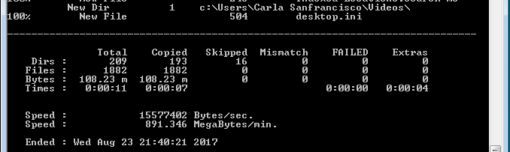
Setup - Extracting User Profile
Enable the built-in Administrator account
Log off, log back in as Administrator
Robocopy user profile

Slide 16
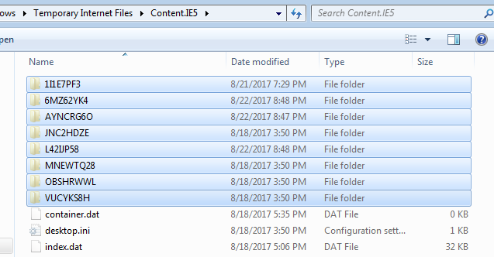
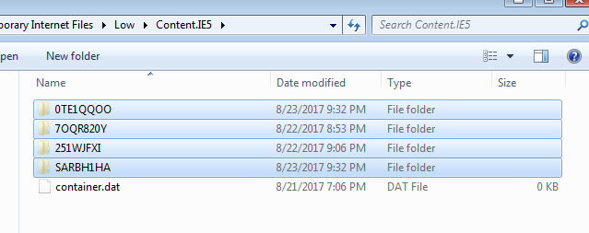
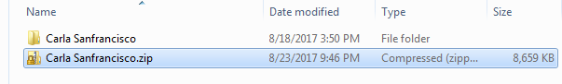
Setup - Extracting User Profile
Delete content folders from Temporary Internet Files
Windows couldn’t zip Unicode characters
Zip folder
Copy/paste to host machine
Student downloads zip file, extracts

Slide 17
Prompt
World-infamous supercriminal Carla Sanfrancisco just stole all the deep dish pizza in Chicago! ACME detectives lost her trail somewhere in the Windy City, but they managed to nab her laptop. ACME has extracted Carla’s user profile folder (C:\Users\Carla Sanfrancisco) and have sent it to you for analysis. Can you uncover the clues she left behind and figure out where she’s headed next? And what is her next target?

Slide 18
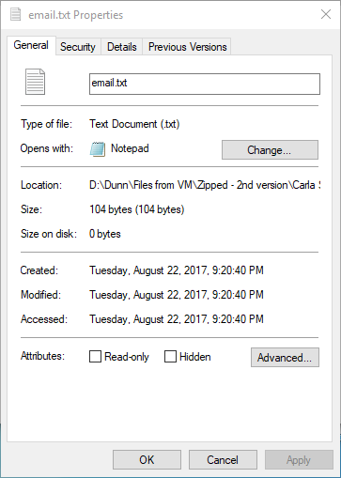
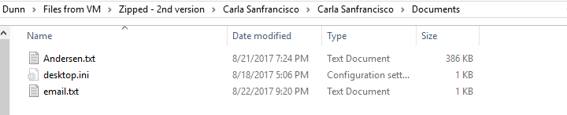
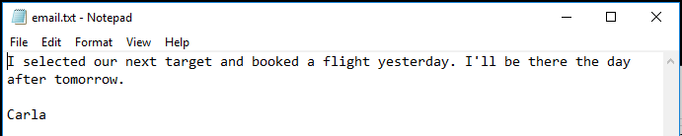
Evidence
File: \Documents\email.txt
Based on file modified time, Carla booked her flight on August 21, and will arrive at her destination on August 24.
Notes:
Establishes timeline for when she selected her target and when she’ll arrive at her next target location

Slide 19
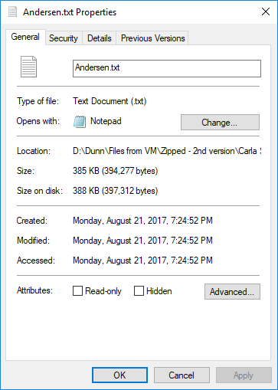
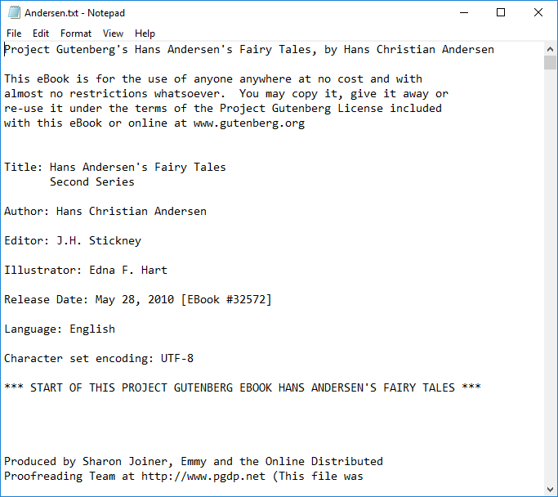
Evidence
File: \Documents\Andersen.txt
Copy of Andersen’s Fairy Tales, by Hans Christian Andersen
From “Project Gutenberg” (www.gutenberg.org)
Notes:
We’ll come back to this

Slide 20
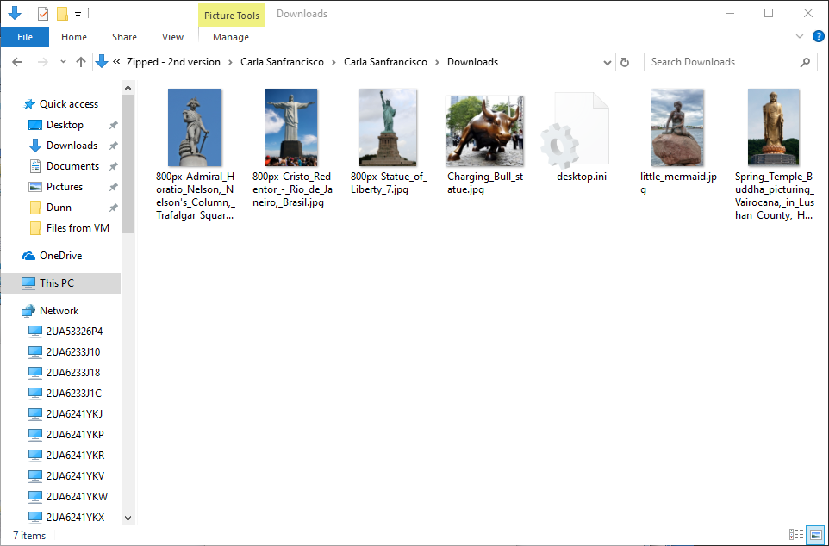
Evidence
Folder: \Downloads
Notes:
Theme: iconic statues
Next: set view to Details

Slide 21
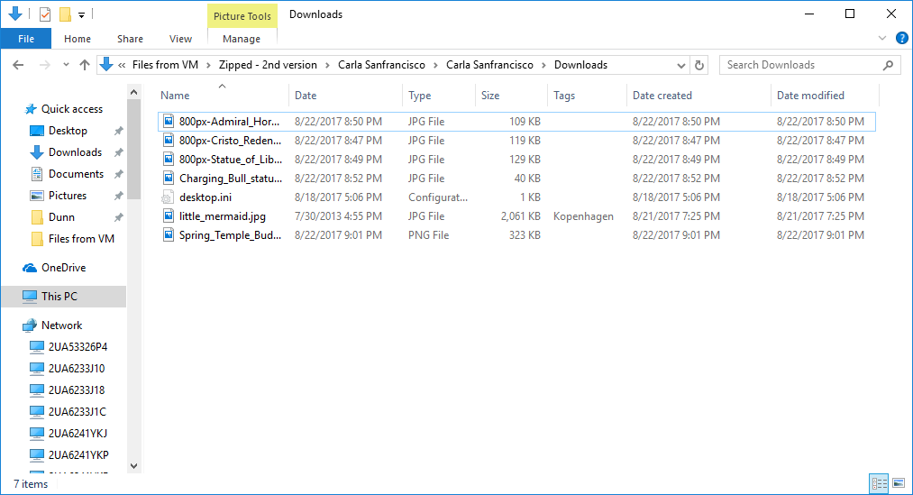
Evidence
Folder: \Downloads
Right-click Properties bar, select “Date created” and “Date modified”

Slide 22
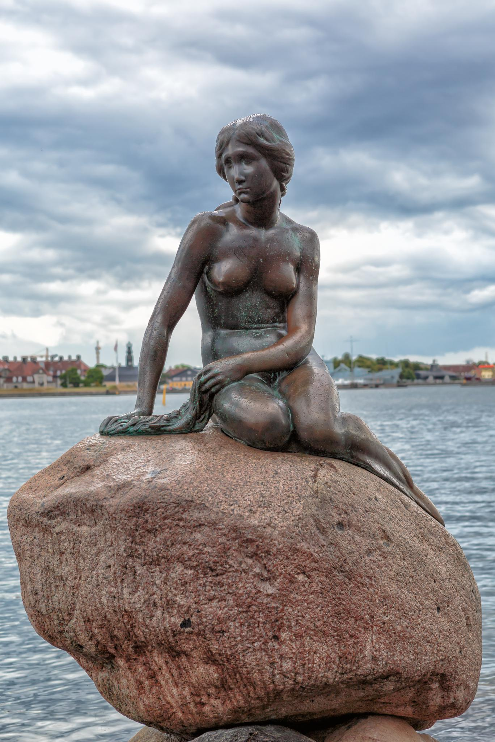
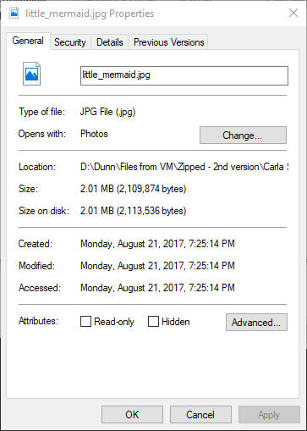
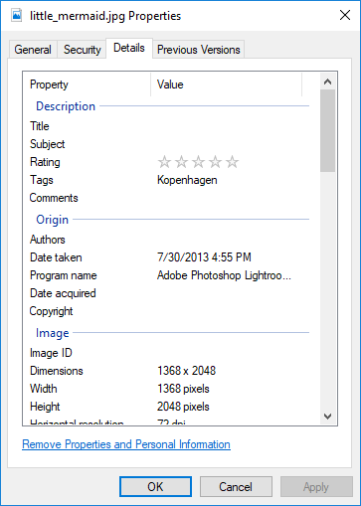
Evidence
File: \Downloads\little_mermaid.jpg

Slide 23
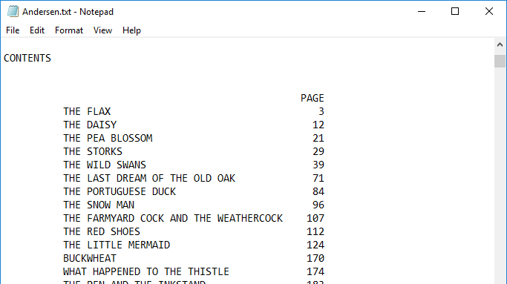
Evidence
Remember this file?

Slide 24
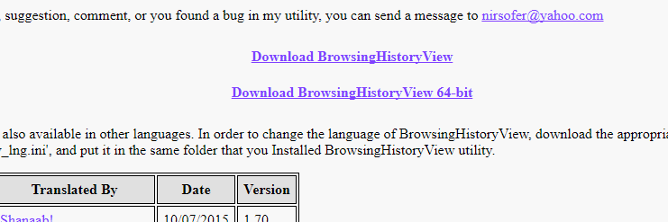
Evidence – Browsing History
Browsing history stored in \AppData\Local\Microsoft\Windows\History\
Windows won’t just open it – tool required
BrowsingHistoryView v2.10, from NirSoft
http://www.nirsoft.net/utils/browsing_history_view.html

Slide 25
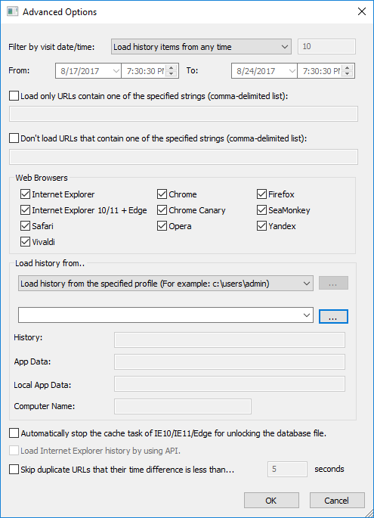
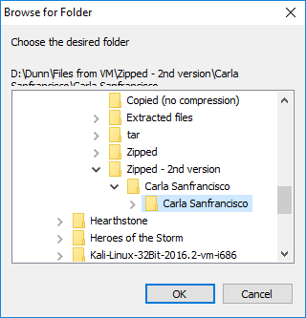
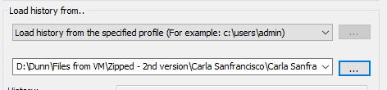
Filter by visit date/time: any time
Load history from the specified profile
Select unzipped user profile
Click OK

Slide 26
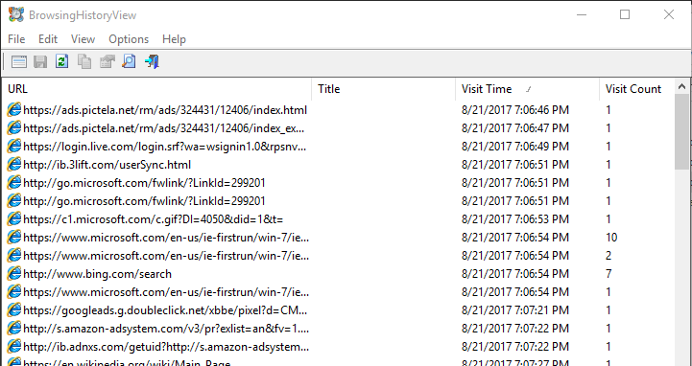
Evidence – Browsing History

Slide 27
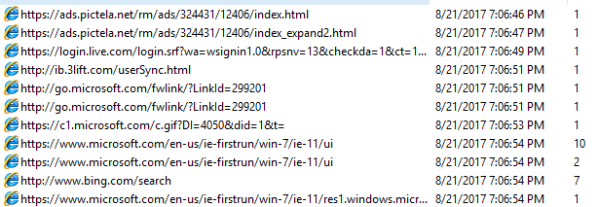
Evidence – Browsing History
Open browser: August 21, 2017, 7:06 PM

Slide 28
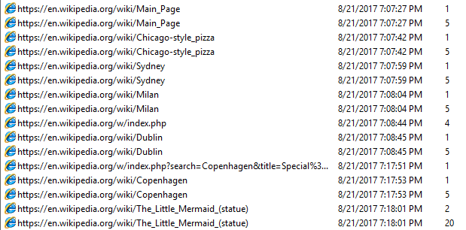
Evidence – Browsing History
Wikipedia

Slide 29
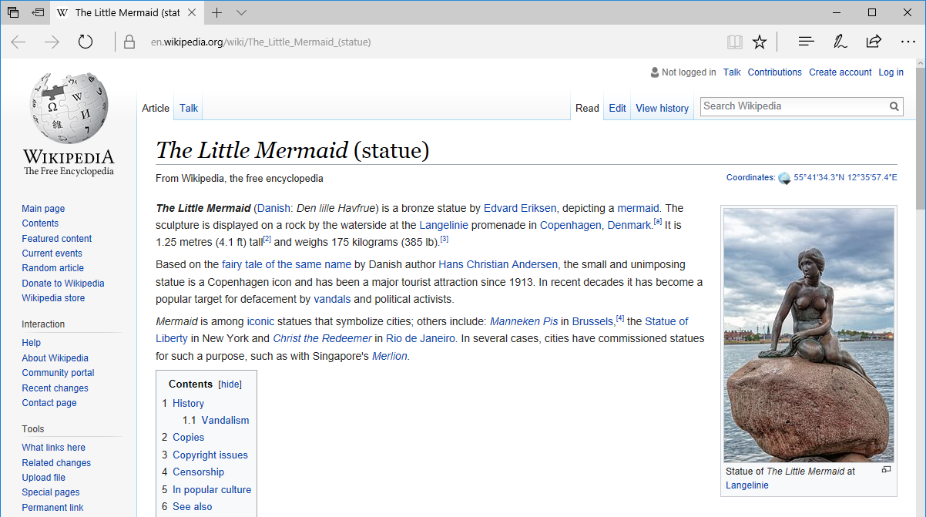
Evidence – Browsing History
Wikipedia

Slide 30
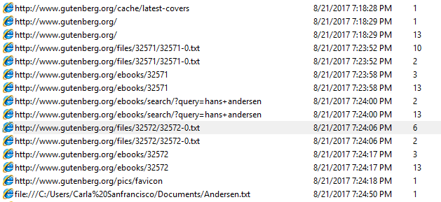
Evidence – Browsing History
Gutenberg.org

Slide 31
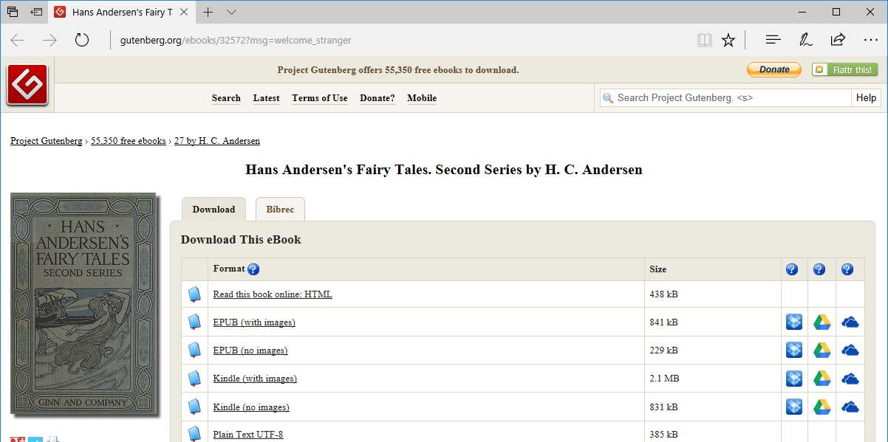
Evidence – Browsing History
Gutenberg.org

Slide 32
Evidence – Browsing History
Gutenberg.org

Slide 33
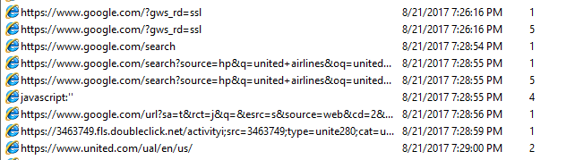
Evidence – Browsing History
Google
Searched “united airlines”
Clicked linked to United Airlines U.S. homepage

Slide 34
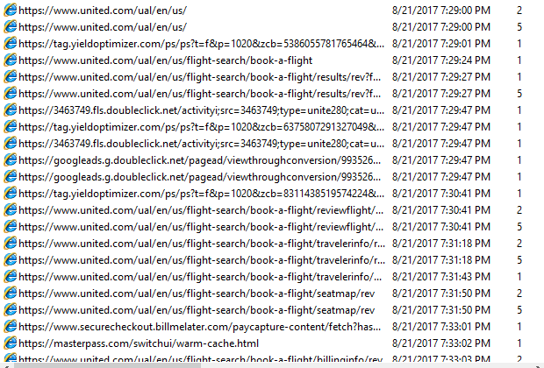
Evidence – Browsing History
United Airlines
Searched for flight
From ORD (Chicago O’Hare)
To CPH (Copenhagen)
Departing August 23, 2017

Slide 35
Evidence – Browsing History
United Airlines
Selected and booked a flight

Slide 36
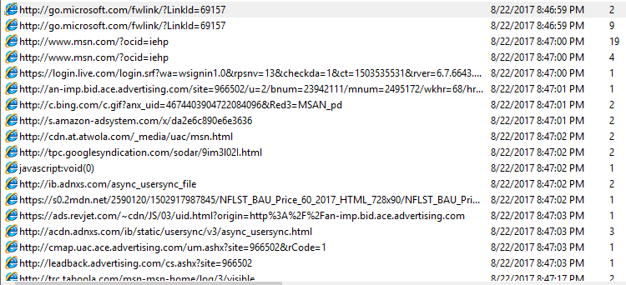
Evidence – Browsing History
Open browser: August 22, 2017, 8:46 PM

Slide 37

Evidence – Browsing History
Wikipedia
Downloaded photo of Christ the Redeemer statue

Slide 38

Evidence – Browsing History
Bing
Searched “iconic statues” (using the IE Search Box)

Slide 39
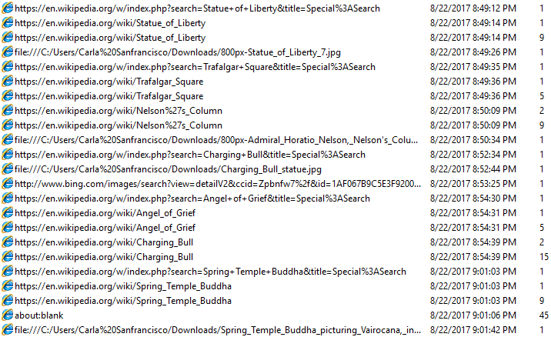
Evidence – Browsing History
Wikipedia
Downloaded more photos of iconic statues

Slide 40
Evidence – Browsing History
Wikipedia
Downloaded more photos of iconic statues

Slide 41
Challenge Questions
What cities did Carla look up?
What is the title of the book downloaded from Gutenberg.org?
What time did she download the book from Project Gutenberg?
What date and time was the file email.txt last modified?
What date did Carla book her flight?
What airline is she flying?
What airport is she flying out of?
What date will she arrive?

Slide 42
Challenge Questions
And the big ones . . .
What city is Carla headed to?
What is her next target?

Slide 43

Goals Revisited
Engaging (hands-on)
Students must do something, not just look stuff up and answer questions
Scalable
Adaptable to small or large number of participants
Introductory level
Appropriate for students in grades 6-12
Basic computer skills
Could be accomplished after brief forensics instruction or with some googling
Low cost
No special software or licenses required
Students get real files to look at, manipulate, and analyze
Use real tool
Files can be easily distributed
Small #: report or group discussion
Large #: answer questions on website, scored automatically
Basic file manipulation
Browser history tool is very easy to use
Files can be analyzed on any computer
Tool is freely available
No licenses required

Slide 44
Summary
Part 1: Survey of Existing Activities
Methodology
Evaluation of Activities
Part 2: Create an Activity
Goals
Learning Objectives
Premise
Setup
Evidence
Challenge Questions

Slide 45
References
https://cyberforensicschallenge.com/
https://www.facebook.com/BlackTshirtCyberForensicsChallenge/
http://webcache.googleusercontent.com/search?q=cache:DvVpq9m132cJ:www.stevenson.edu/graduate-professional-studies/blog-news-events/cyber-forensics-challenge-2016+&cd=6&hl=en&ct=clnk&gl=us
https://www.youtube.com/watch?v=8PWxq5QU0j8
https://www.youtube.com/watch?v=5NsA_yvujUI
https://www.youtube.com/watch?v=ISnBBp9jdGY
https://www.facebook.com/usdfc/
http://www.securitytreasurehunt.com/

